Slide 1

OxiScience NonScents’ Sales & AdWord Spend Data Analysis Project Group 3 Roger André, Molly Gordon, Shilpi Mittal, Amanda Jaeger

Slide 2
Facts about OxiScience NonScents?
Overview
Local startup founded in 2015
Specializing in kitty litter and other odor control products
7 product in 4 product groups
eCommerce sales channel - Amazon
Business Problem
Reporting currently done ad hoc in Excel
Lack insights on effectiveness of Google AdWords
No dedicated BA or data analyst

Slide 4


The Dataset
NonScents’ sales order and Google AdWords data for 7 products from July – early November 2017.
Sales Orders
AdWords
Date, Product Price, Qty, Shipping Address
Date, Cost, Clicks
Merged dataset
AdWords, Aggregate Revenue, Calculations

Slide 5
Ask Question(s)
Does Google AdWord spend have an impact on Sales?
Ask Questions
Wrangle Data
Explore Data
Draw Conclusion
Communicate Findings
Considerations
Timing (e.g. day of week)
Focus is on order fulfillment (revenue) and not order placement.
Assumptions:
AdWord payment for clicks
Item price = revenue

Slide 6
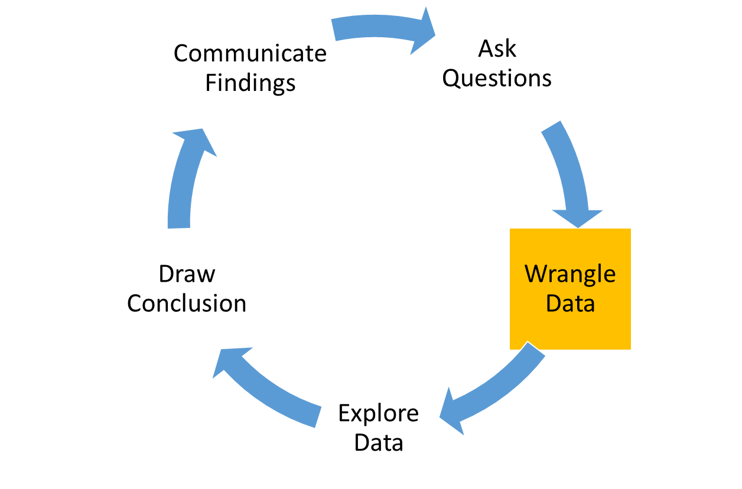
Wrangle Data
Select Columns
Set Data Types
Perform Calculations
Currency conversion (CAD → USD)
Revenue and Quantity aggregate
Clean Data
Remove sample orders ($0 item price)
Narrowed dataset from 35 to 14 columns
Reviewed each column in our datasets to determine which were useful for our analysis
Join Data
Address outliers (“Shipping” status)
Convert date fields to common format with YMD
Product name mapping*
Rename to meaningful column names
Merge sales (aggregate) and AdWord datasets
Perform additional calculations on merged data
Join on Date
Identify and set categorical data (e.g. Status, Product, Country)
Derive day of week, week #, month
Verify Item Price factors in Qty
Filter cancelled orders

Slide 7
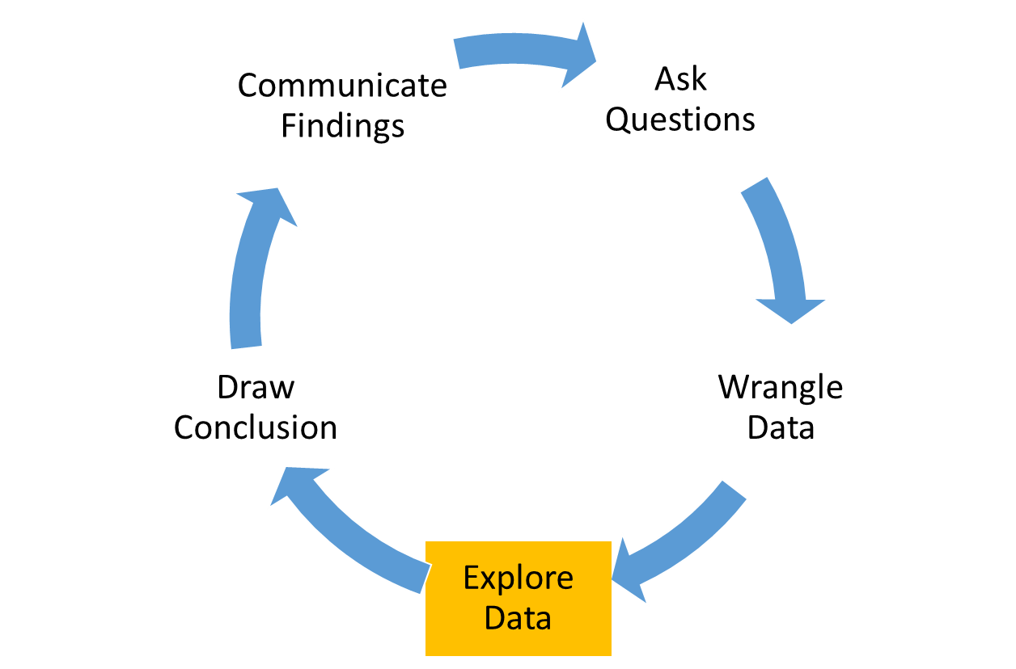
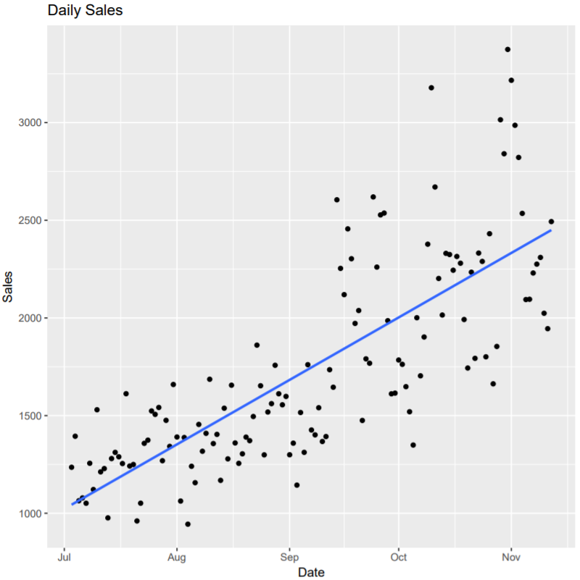
Explore Data
Plot:
Daily Sales by Date
Observations:
Upward Sales Trend!
How can I invest in Kitty litter?!?

Slide 8
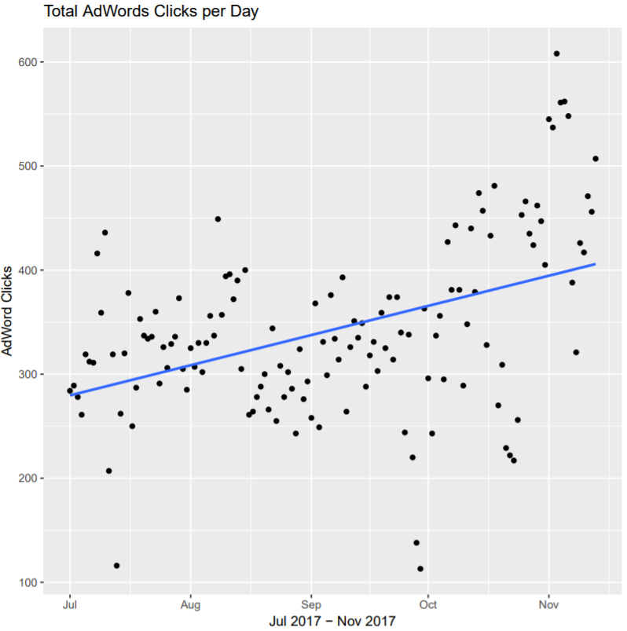
Explore Data cont.
Plot:
Adword Clicks by Date
Observations:
Upward trend!

Slide 9
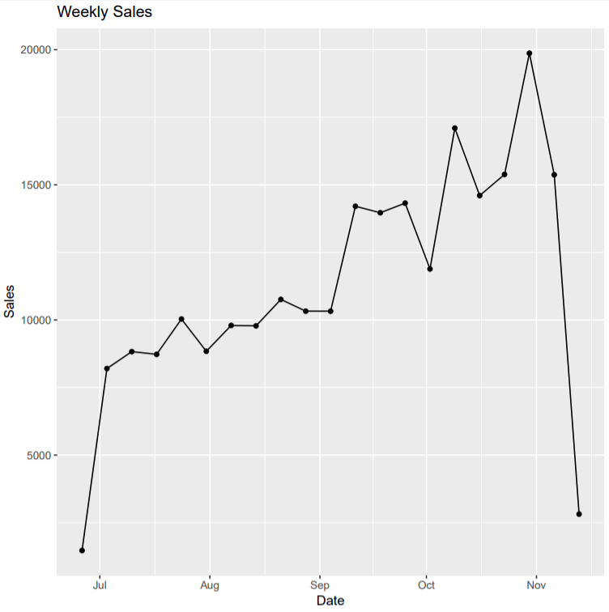
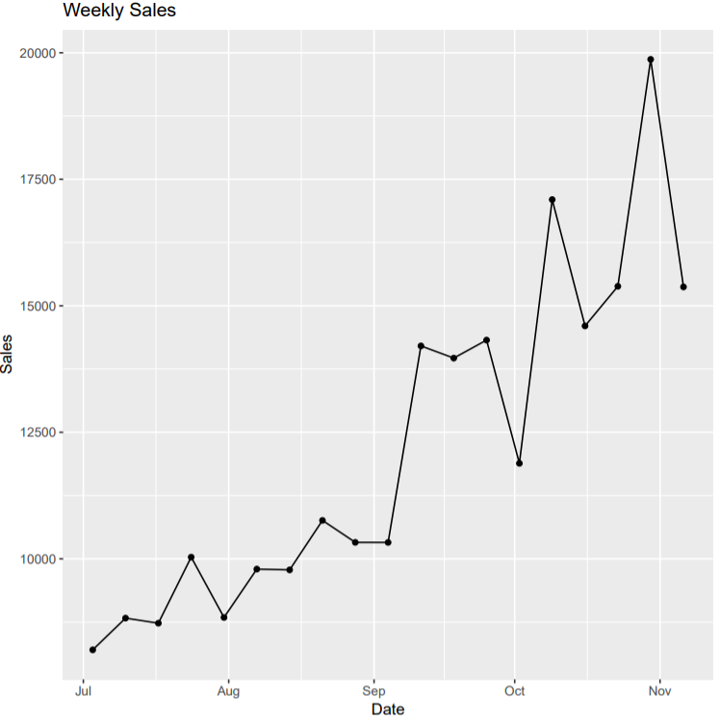
Explore Data cont.
We trimmed the partial weeks of sales (first and last of dataset)

Slide 10
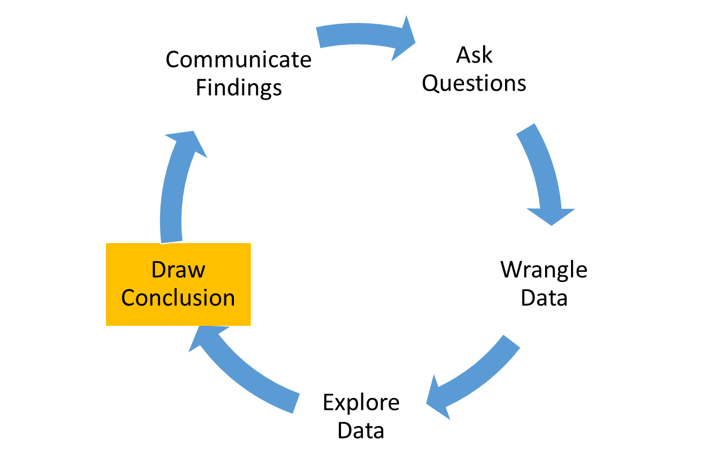
Draw Conclusion

Slide 11
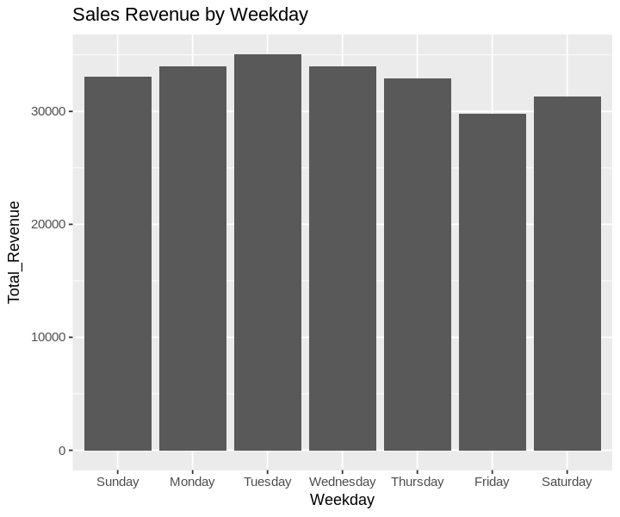
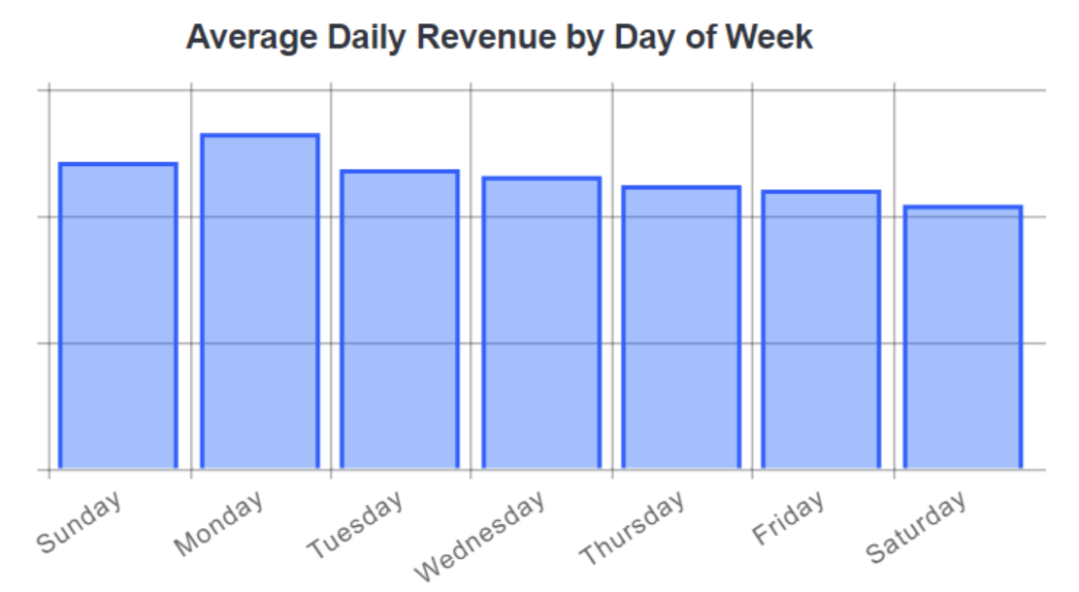
Draw Conclusion Cont
Kitty Litter Revenue aligns with market trends. Sales are higher on Mondays!
https://www.workarea.com/blog_entries/trends-when-do-people-shop-online-updated-for-2017

Slide 12
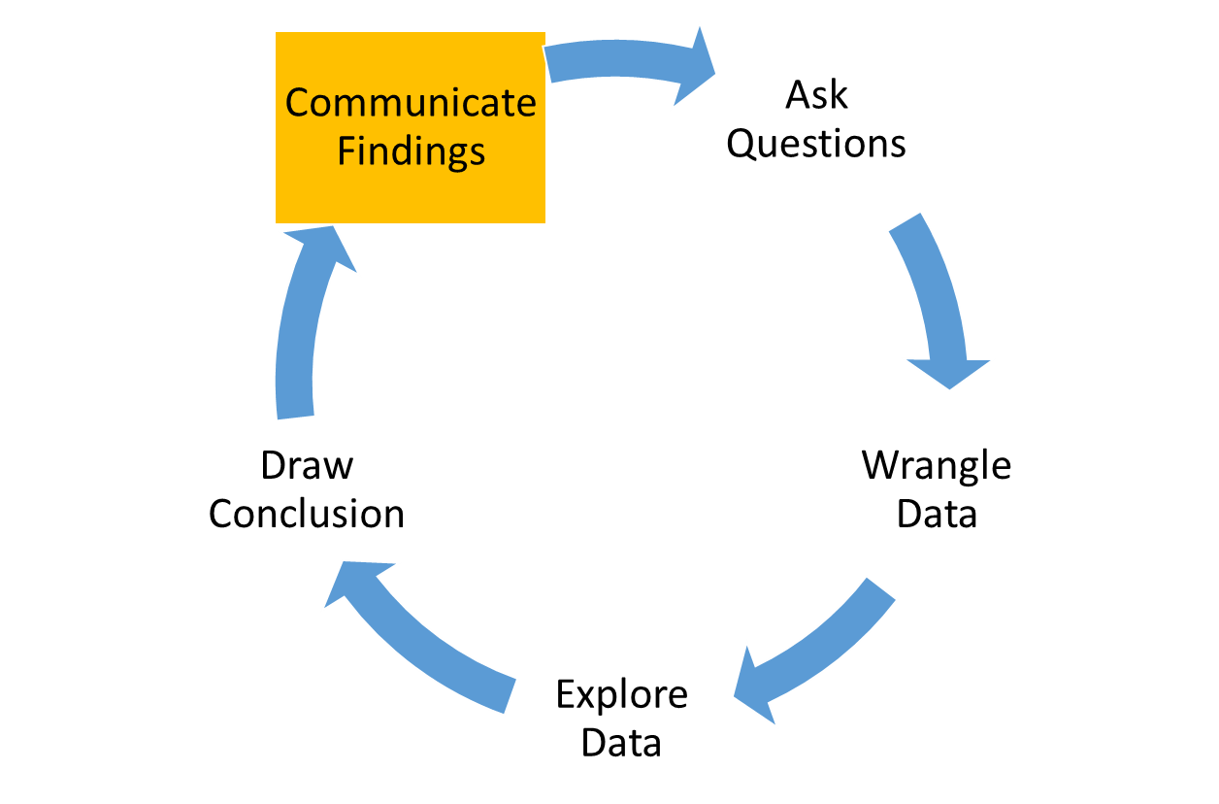
Communicate Findings
Our Question:
Does Google AdWord spend have an impact on Sales?
Answer:
Aligned upward trend: Adword spend & Sales Revenue
Moderate correlation between Revenue and Adword spend (Correlation = 0.55)
30% of sales can be explained by Adwords spend (adjusted r^2 = 0.3)
Recommendations (to OxiScience):
Standardize product naming convention in Amazon
Expand on our work to build monthly, quarterly reporting mechanism
A / B testing for keywords
Rethink the amount spent on Adwords based on recent Revenue generation
Focus on top 3 products (they generate over 85% of Revenue)

Slide 13
R Code

